Slide 1
Trendlines
Advice for choosing a scenario for the trendline case study

Slide 2
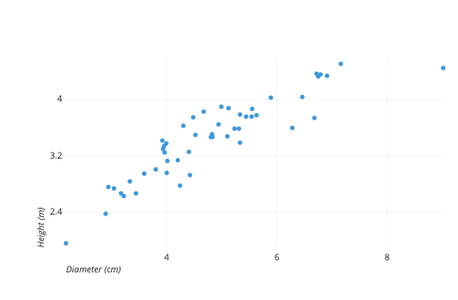
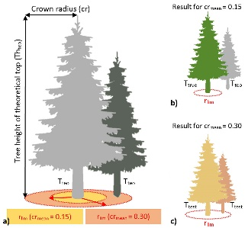
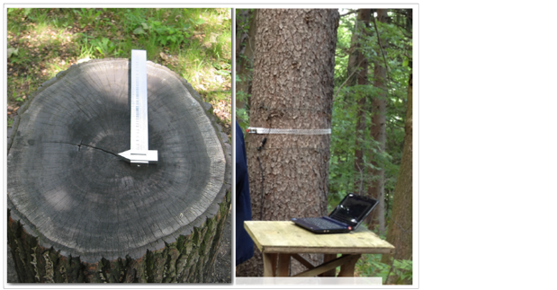

Slide 3
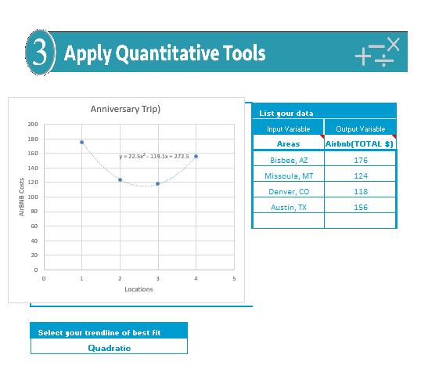

Slide 4
No words!
Numbers

Slide 5
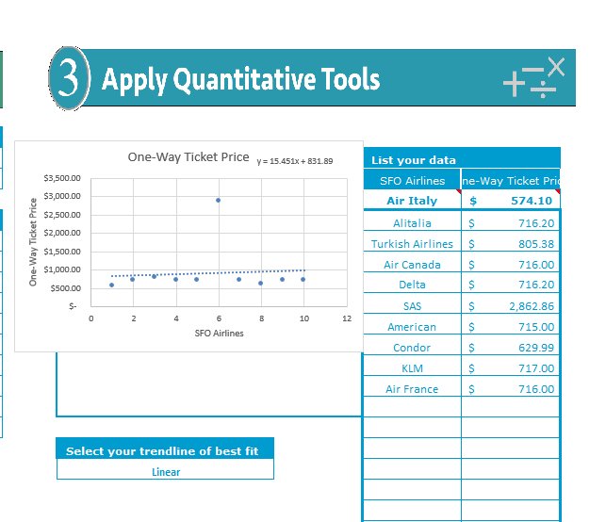

Slide 6
No words!
Numbers only

Slide 7
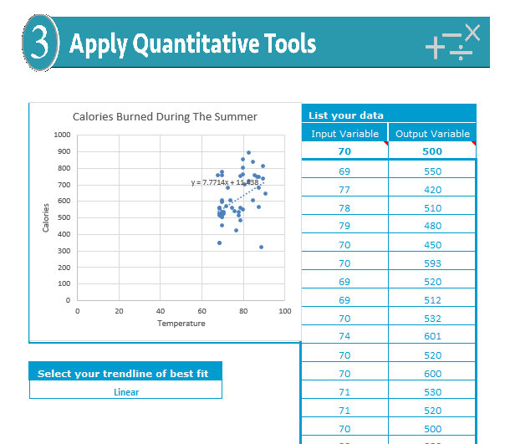

Slide 8
Different people?
Of different weight?
Doing different exercises?
Lots of confounding variables
temperature
Calories burned
Keep it simple!

Slide 9
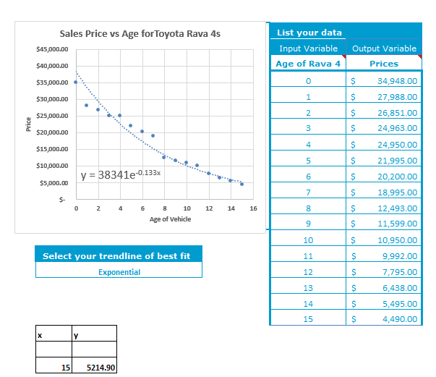
Use real data wherever possible.

Slide 10
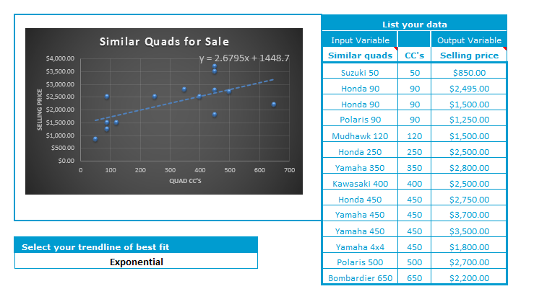
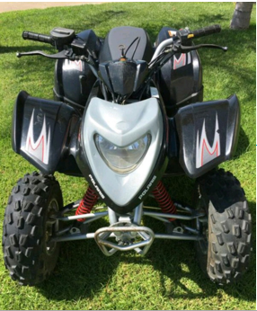

Slide 11
